Slide 1
Kernel Based Offloads of OVS
Simon Horman
OvS+OVN ‘19

Slide 2
Who am I
Long term contributor to Linux kernel and Open vSwitch
OvS Offload Architect & Open Source Coordinator at Netronome

Slide 3
Agenda
Introduction
  Hardware and Software Switching
Offload Architecture
  OVS-TC Datapath
Feature Evolution
  From Stateless to Stateful
Closing Remarks

Slide 4
Hardware and Software Switching

Slide 5
Historically Switching Done in Hardware
Dedicated physical switch
Fast
Fixed feature set
Inflexible

Slide 6
Virtualisation Moved Switching to Host
Desire to share network between hosts and VMs
Software bridging or user-space networking used to achieve this
Flexible
Slow

Slide 7
SR-IOV Moved Hardware Switching to the Host
Embedded switch between
  Physical Port
  “PF” network interfaces used by host
  VF network interfaces used by VMs
Performance improvement over software based switching to VMs
Reduced flexibility

Slide 8
SDN Moved Host Switching Back into Software
Exploited flexibility of software
Many features emerged: f.e.:
  Tunnel Termination
  Rich flow key for matching on L2 ~ L4
  Packet modification possible: set packet header fields
  QoS
  Stateful Security Policies (Conntrack)
  NAT
  Increasing programmability
Slow/consumes CPU resources

Slide 9
Host Datapath Acceleration
Combine flexibility of software with performance of hardware
Hardware
Software
Fast
Inflexible
Host Data Plane Acceleration
Flexible
Slow
Pendulum motive credit: Rashid Khan, “Red Hat’s perspective on OVS HW Offload Status”, presented at Open vSwtich 2017 Conference

Slide 10
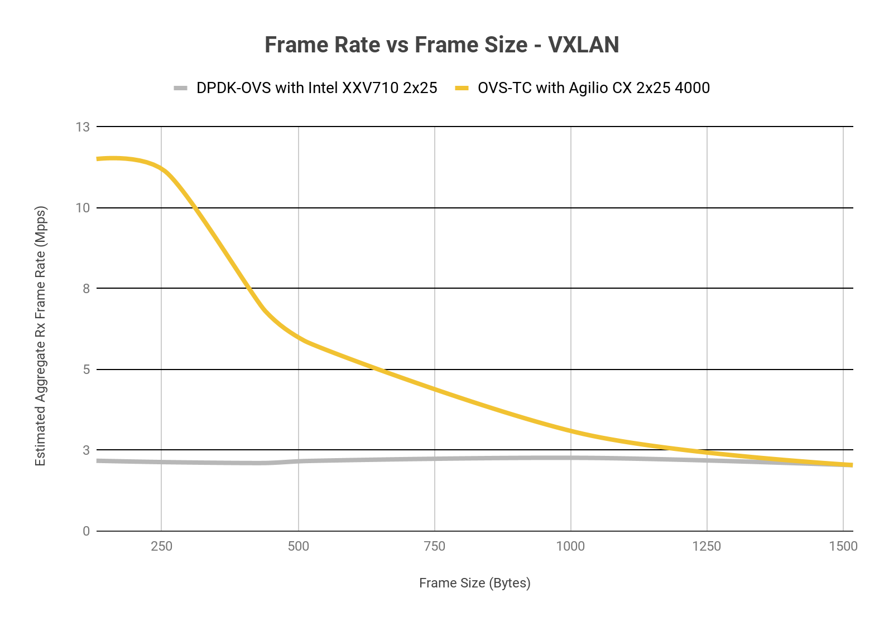
Netronome Agilio OVS Offload Performance
Agilio CX 2x25 SmartNICs on RHEL 7.5 OVS-TC Offload
Benchmarked against latest Intel Fortville 2x25 NICs on the same RHEL 7.5-based server
6X throughout relative to Intel NICs with OVS-DPDK
Scales to over 2 million flows with superior performance
>20X higher performance
per Xeon Core with Agilio CX
1 XEON CPU CORE CONSUMED
8 XEON CPU CORES CONSUMED
Notes:
Intel(R)-Xeon(R)-CPU-E5-2630-v4-@-2.20GHz ?

Slide 11
Kernel-Based OVS Offload Architecture

Slide 12
Earlier Approaches
ofproto level offload
  Allows more holistic approach to HW datapath implementation
  But requires all features of datapath to be implemented in HW
Kernel datapath hooks
  Allows case-by case offload of flows
  Hooks to add/delete flows, and collect stats
  Minimal changes to kernel and user-space infrastructure
  Not accepted by upstream

Slide 13
Upstream Requirements
All features of HW datapath must be implemented in SW datapath
Offload mechanism should be re-usable
TC based datapath meets these requirements

Slide 14
OVS Kernel Datapath
1
Flow table miss
x86 Userspace
Virtual Machine
2
ovs-vswitchd populates kernel cache; instructs OVS kernel DP to execute packet
Virtual Machine
Open vSwitch Subsystem
Virtual Machine
Virtual Machine
ovs-vswitchd
Apps
1
Miss
2
x86 Kernel
OVS
Kernel DP
VirtIO

Slide 15
OVS-TC Datapath Offload
1
Flow table miss
x86 Userspace
Virtual Machine
2
ovs-vswitchd populates kernel cache; instructs OVS kernel DP to execute packet
Virtual Machine
Open vSwitch Subsystem
Virtual Machine
Virtual Machine
3
Offload datapath: copy match tables, sync stats
ovs-vswitchd
Apps
2
x86 Kernel
Miss
TC
Kernel DP
OVS
Kernel DP
SR-IOV
SR-IOV VFs /
VirtIO
Miss
PCIe
3
Miss
Agilio SmartNIC
1
Open vSwitch Datapath
Miss
OVS
Kernel DP
Execute Action
4

Slide 16
Feature Evolution

Slide 17
Status
 | Matches | Actions | Tunnels and LAG
v2.8 | Basic L2 – L4, tunnel metadata | Drop, VLAN, single-port output | VXLAN Geneve
v2.9 | IPv4 TTL, TCP Flags | Set basic L2 – L4
v2.10 | IP fragments, IPv6 hlimit, IPv4 DSCP & ECN |  | Flows on Linux bonds
v2.11 | MPLS QinQ IPv4 DSCP & ECN | QinQ, set IPv6 hlimit, | Geneve options IP tunnel TTL, DSCP & ECN
v2.12 | VLAN priority with TCI 0 | Set IPv6 TC, and IPv4 DSCP & ECN | Ingress port rate limiting Tunnel endpoint on bridge, tunnel over Linux bond
v2.13 |  | MPLS

Slide 18
Future Directions
Conntrack and NAT
More QoS: Egress shaping, Metering
vDPA: vendor neutral drivers in VMs, live migration
Notes:
Simple -> Complex
Stateless -> Stateful

Slide 19
Thank You

